Slide 1

Blockchain Technology
FOR WEB3 AND CRYPTOCURRENCY
Submitted By:
Abin B Vinod

Slide 2
CONTENTS
BLOCKCHAIN
WEB3
CRYPTOCURRENCY
PROBLEM STATEMENT
EXISTING SYSTEM
PROPOSED SYSTEM
CONCULSION
REFERENCES

Slide 3
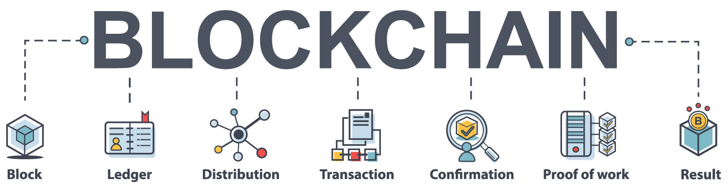
What is blockchain ?
INTRODUCTION
A technology that permits transaction to be gathered into blocks and recorded. a distributed ledger technology, enables a layer of trust and eliminates the need for a third party to validate the transactions.

Slide 4
LITERATURE SURVEY
SL.NO | AUTHOR | TITLE AND YEAR OF THE PAPER | CONCLUSION
1 | Satoshi Nakamoto | Bitcoin: A Peer-to-Peer Electronic Cash System (2008) | Electronic payment system based on cryptographic proof instead of trust, allowing any two willing parties to transact directly with each other without the need for a trusted third party.
2 | Zibin Zheng, Shaoan Xie, , Hongning Dai | An Overview of Blockchain Technology: Architecture, Consensus, and Future Trends(2018) | In this paper, we present a comprehensive overview on blockchain. We first give an overview of blockchain technologies including blockchain architecture and key characteristics of blockchain.

Slide 5
SL.NO | AUTHOR | TITLE AND YEAR OF THE PAPER | CONCLUSION
3 | Siddharth Rajput, Archana Singh, Smiti Khurana | Blockchain Technology and Cryptocurrenices (2019) | Blockchain is the development spine of Bitcoin. The passed on record value joined with security of BlockChain, makes it to a great degree charming advancement to understand the current Financial and furthermore non-cash related business issues.
4 | Zhan Su, Hejian Wang, Huanjuan WaNG | A Financial data security sharing solution based blockchain technology and proxy re-encryption technology(2020) | The Safe and reliable sharing of data between different subjects is always a hot research issue. Protecting the privacy of sensitive financial data, realizing the secure sharing of sensitive data based on blockchain

Slide 6
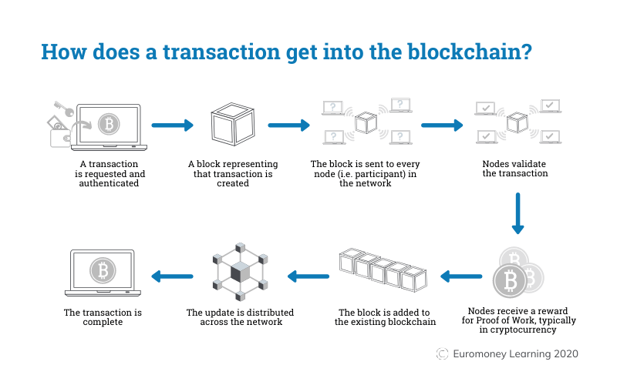
HOW DOES BLOCKCHAIN WORKS.?

Slide 7
TYPES OF LEDGER
Centralized Ledger Distributed Ledger
Client A
Node A
Bank
Node E
Node B
Client B
Client C
Client D
Node D
Node C
There are multiple ledgers, but Bank holds the “golden record”
Client B must reconcile its own ledger against that of Bank, and must convince Bank of the “true state” of the Bank ledger if discrepancies arise
There is one ledger. All Nodes have some level of access to that ledger.
All Nodes agree to a protocol that determines the “true state” of the ledger at any point in time. The application of this protocol is sometimes called “achieving consensus.”

Slide 8
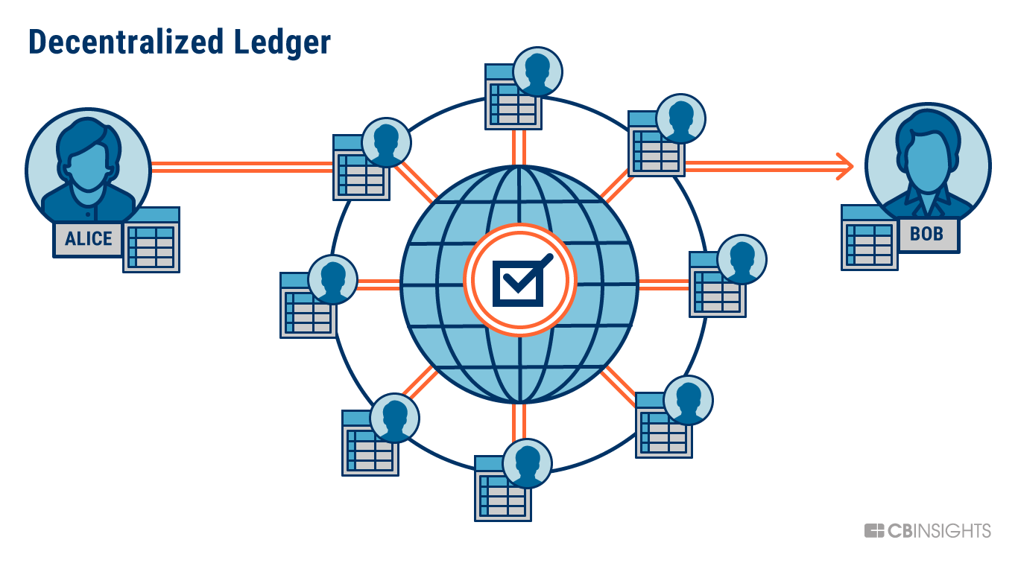

Slide 9
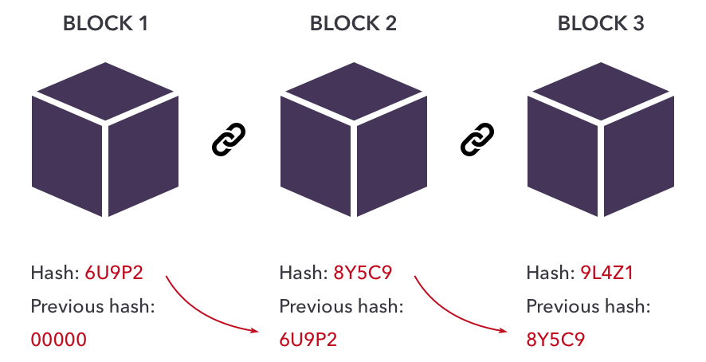
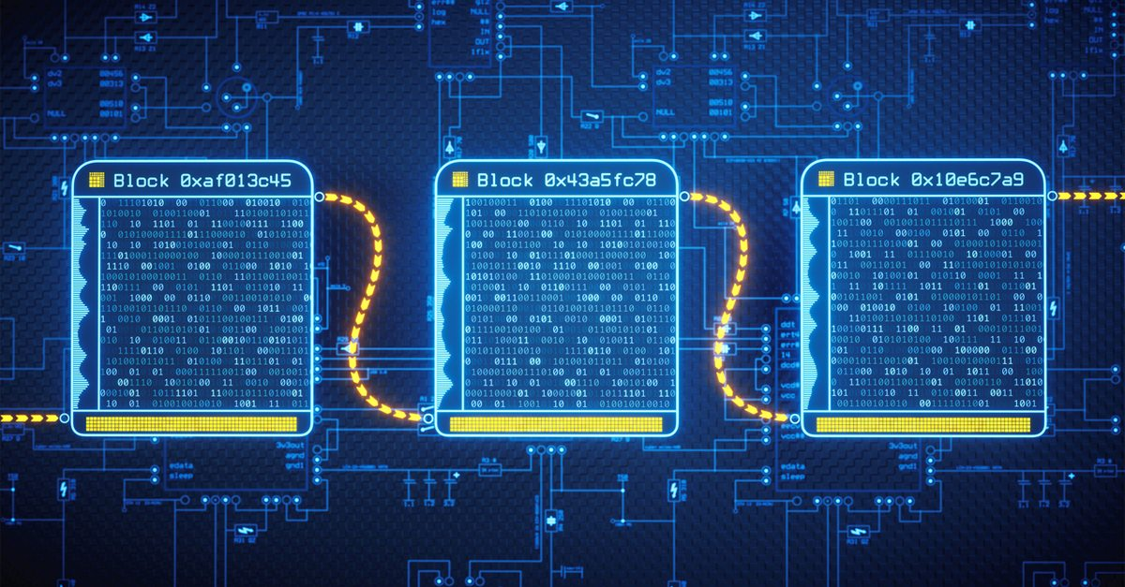
BLOCKCHAIN NODES

Slide 10
BLOCKCHAIN USE OF CRYPTOGRAPHY
Initiation and Broadcasting of Transaction
Digital Signatures
Private / Public Keys
Validation of Transaction
Proof of Work
Chaining Blocks
Hash Function

Slide 11
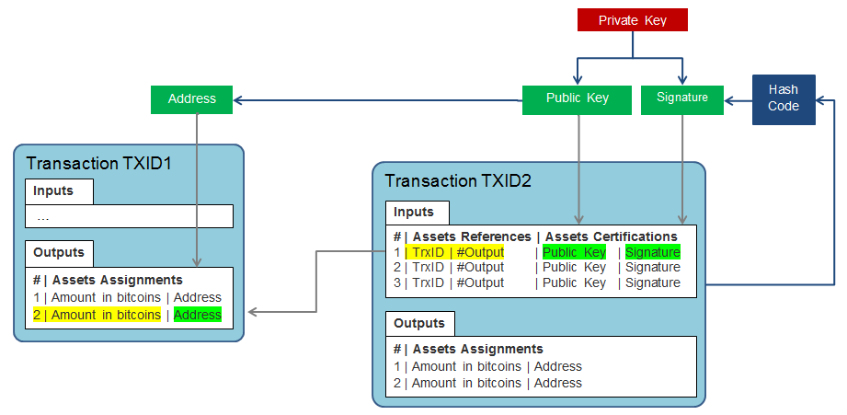
Notes:
This diagram presents the structure of a transaction and the locks set with the user’s private keys, which shows the interest of cryptography for blockchain.

Slide 12
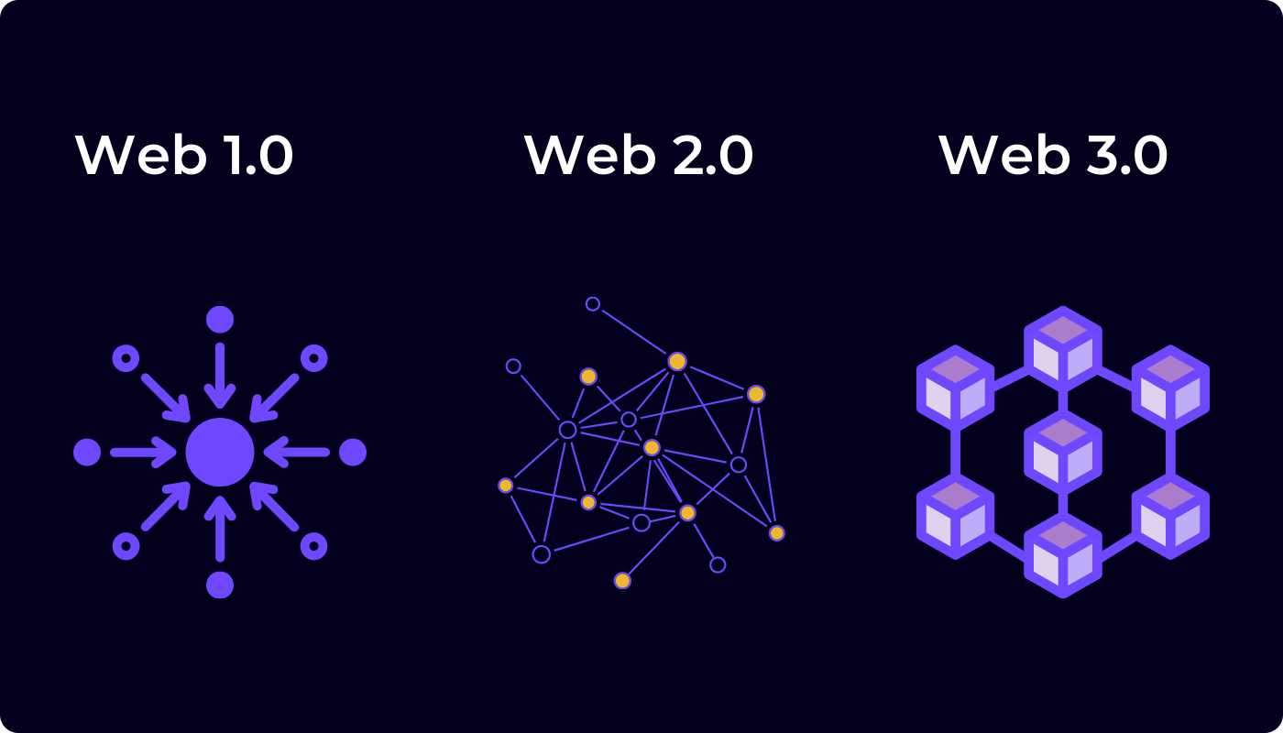
WEB3
WHAT IS WEB3 ?
Web3 is an idea for a new iteration of the World Wide Web based on blockchain technology

Slide 13
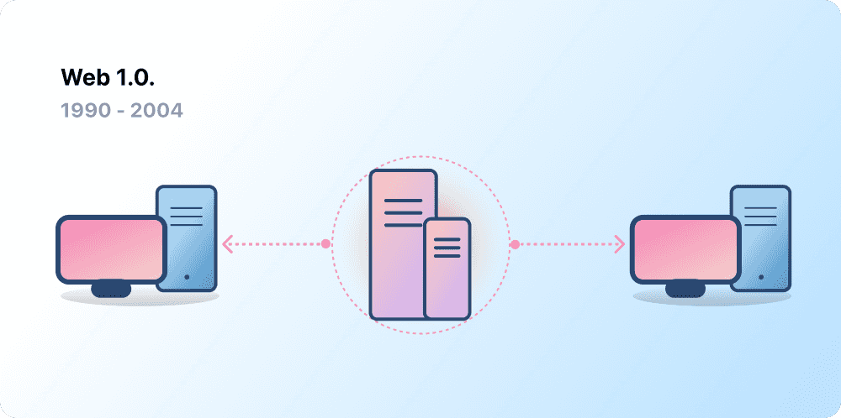
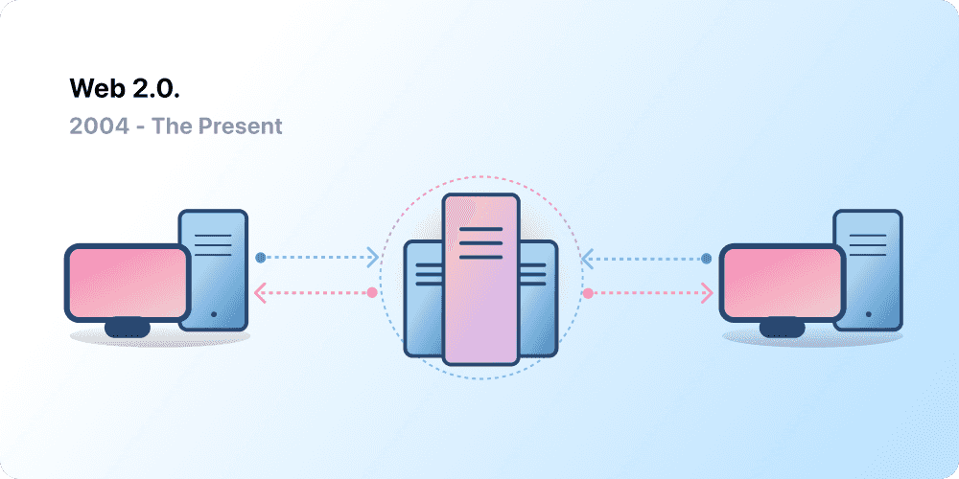
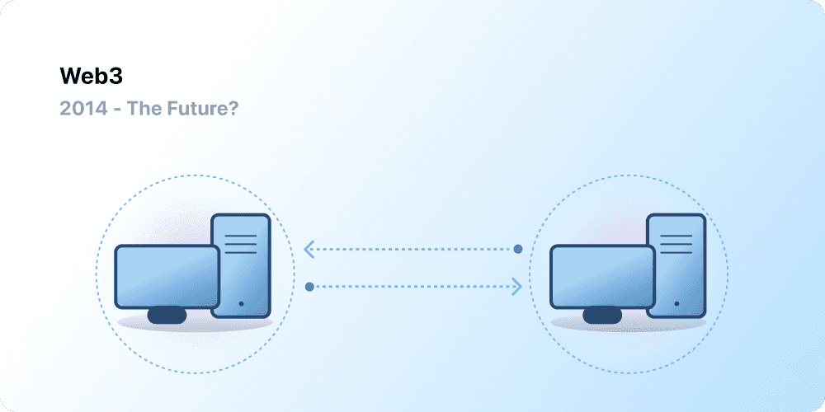
WEB 1
READ
WEB 2
READ , WRITE
WEB 3
READ , WRITE , DATA

Slide 14
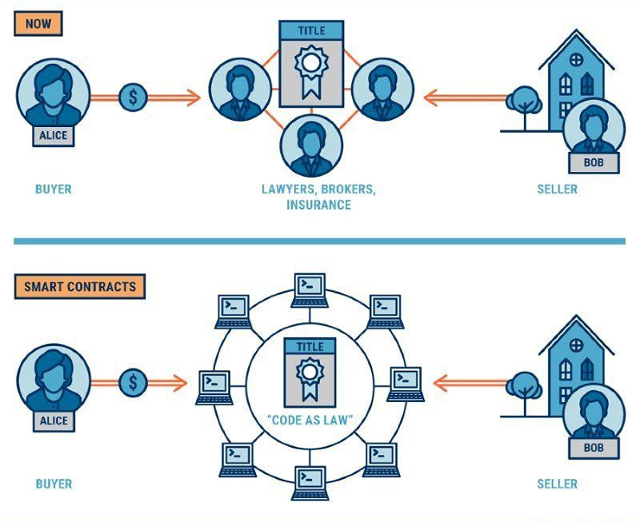
SMART CONTRACT
Business rules implied by the contract . .
Embedded in the Blockchain &
executed with the transaction
Verifiable, signed
Encoded in programming language
Example:
– Defines contractual conditions under which corporate Bond transfer occurs

Slide 15





BLOCKCHAIN USED FOR CRYPTOCURRENCY
Bitcoin
Crypto currency, first asset based on Blockchain
“What is needed is an electronic payment system based on cryptographic proof instead of trust, allowing any two willing parties to transact directly with each other without the need for a trusted third party.”
Satoshi Nakamoto – October 31st, 2008
Ethereum
Smart Contract , NFT
XRP
ADA
USDT

Slide 16
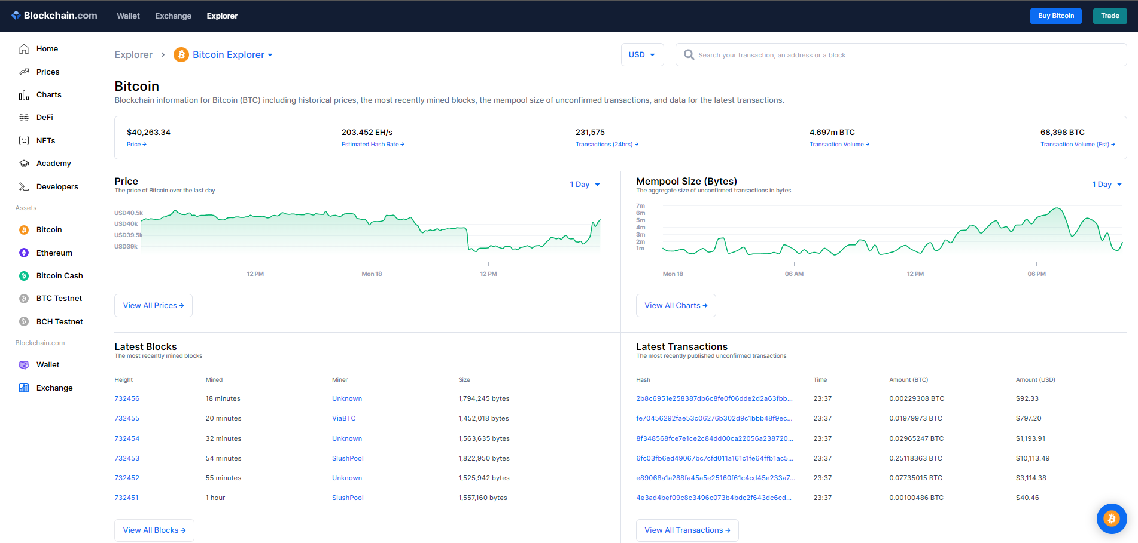
TRANSACTIONS IN BLOCKCHAIN

Slide 17
PROBLEM STATEMENT
You go to your bank and ask the banker to transfer a certain amount from your account to that of your companion’s. The bank registers this in their internal servers. This record needs to be updated on both, receivers’ and senders’, accounts. The procedure may seems simple but a problem, which cannot be disregarded is that this data may get hacked. Records of transactions can be manipulated easily or changed. To resolve this issue, Blockchain comes in.

Slide 18
EXISITING SYSTEM
Bitcoin
Bitcoin Transactions
Ethereum Blockchain

Slide 19
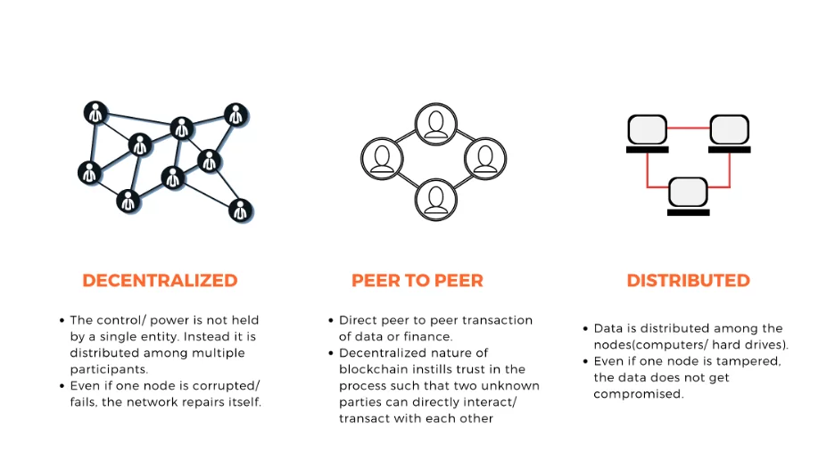
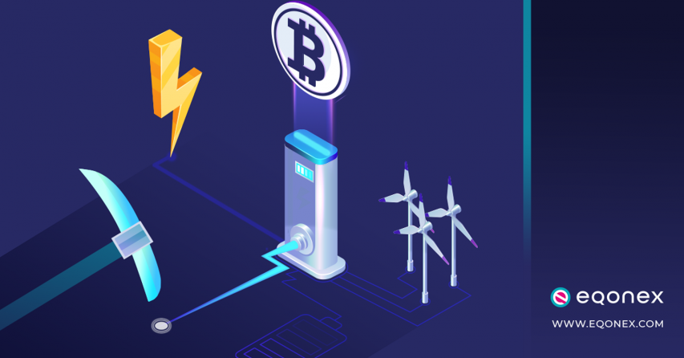
PROPOSED SYSTEM
Advantages
Decentralized
Secured
Trusted
Peer to Peer
Disadvantages
Energy Consumption
Lack of Knowledge
Regulation

Slide 20
The technology will affect every industry in the world, including manufacturing, retail, transportation, healthcare, and real estate . Blockchain Is the Future
CONCLUSION

Slide 21
REFERENCES
S. Nakamoto, “Bitcoin: A peer-to-peer electronic cash system,” 2008. [Online]. Available: https://bitcoin.org/bitcoin.pdf
G. Foroglou and A.-L. Tsilidou, “Further applications of the blockchain,” 2018.
A. Kosba, A. Miller, E. Shi, Z. Wen, and C. Papamanthou, “Hawk: The blockchain model of cryptography and privacy-preserving smart contracts,” in Proceedings of IEEE Symposium on Security and Privacy (SP), San Jose, CA, USA, 2016, pp. 839–858.
M. Samaniego and R. Deters, "Blockchain as a Service for IoT," Proc. - 2016 IEEE Int. Conf. Internet Things; IEEE Green Comput. Commun. IEEE Cyber, Phys. Soc. Comput. IEEE Smart Data, iThings-GreenCom-CPSCom-SmartData 2016, pp. 433- 436,2020.
C. Ehmke, F. Wessling, and C. M. Friedrich, "Proof-of-property: a lightweight and scalable blockchain protocol," Int. Work. Emerg. Trends Softw. Eng. Blockchain Proof-of-Property, no. January, pp. 48-51,2019.

Slide 22
THANK YOU

